Slide 1
ACE – Assignment Evaluation Topic: Automatic assignment of issues or bugs Presenter: Ashwinkumar Sharma

Slide 2
Background and Problem Statement
Problem Statement :
In a small team, QA is aware of knowledge area of developers in his team. So he directly assigns
bugs to that particular member of the team. But his awareness is acquired with experience and
over a certain period of time. This knowledge is locked with him. Our system will try to capture and
analyze this knowledge.
In large project increasing time of resource is taken to properly assign issues to correct person.
This is inefficient use of time and resources of company’s resources and affects responsiveness. This also affects company’s competitiveness. So system may be used to assist in reducing
response time.
The aim is to develop a system to predict assignment of bug/issue to developer. This will use
Machine Learning and Text Mining algorithm which will work on issue base such as JIRA.

Slide 3
ACE Goals & Timelines - Target Vs Actual
Milestone | Milestone Details | Planned Submission Date | Actual Submission Date
Week 0 | Selection of Assignment Topic | 11-06-18 | 07-06-18
Week 2 | Creation, analyzing, reduction and normalization of annotated data set and storing it in in Excel format. | 25-06-18 | 25-06-18
Week 4 | Understanding TF-IDF, NLTK, Topic modeling, cosine similarity. | 09-07-19 | 09-07-19
Week 6 | Creating TFIDF matrix and building cosine relation between data. | 23-07-19 | 23-07-19
Week 8 | Completing TFIDF model and testing it with data. | 06-08-19 | 15-07-19
Week 10 | Improving the model accuracy and simultaneously exploring alternate models. | 20-08-19 | 03-09-19
Week 12 | Creating presentation related documents. | 03-09-19 | 02-10-19
Week 14 | Submitting solution to ERS-github

Slide 4
Mentor-Mentee – Interactions
Meeting Schedule
We used to have a weekly meeting with my mentor Ritesh Sinha to access the progress.
Summary of minutes of the meetings :
We discussed what are my learning objective and as per that finalized the topic for the
assignment.
Ritesh suggested to create a annotated data set in some format i.e. Excel, and then figuring what all relevant data (in column format) is needed.
Next challenge was to understand domain and platform to work on, for this activity. So we narrowed on Python and recommendation was to explored topics such as TF-IDF, NLTK, Topic modeling, similarity/ cosine relations.
Then in next few meetings we worked on improving accuracy and computation time improvements.

Slide 5
Knowledge Gained from ACE
Programming Language Improvement : Need to brush up Python for this assignment.
Data Preparation.
Learned tools such as TF-IDF, Cosine Similarity, Jaccard Similarity and library such as sklearn and nltk.
Went trough the process cycle of improvement in accuracy and performance.

Slide 6
Business Impact
The solution can be useful for our internal GTS team, so will propose this to them.
It can be a generic use case for topic modeling since it labels (developer) to MultiClass (bug report).

Slide 7
ACE-3 – Feedback on the Program
This is a good initiative from ACE team. It encouraged me to explore domain which was totally new to me. I believe, the structure of program where each mentee is assigned a mentor, is key for the success of the program. Timely and proper inputs provided by mentor helped me to navigate the program with confidence.

Slide 9
Application Insight
Automatic assignment of issue software tries to capture and learns from the existing bug base, so that it can predict assignment for the new bugs reported. Such problems are generally classified under Text Classification and supervised learning domain.
The system can run in three modes:
Simulation mode : This can be used as a validation mode to test the accuracy of the system.
Training mode : This can be used to train system so that there is correspondence of developer with bugs they fixed.
Query mode : This can be used to assign new bug reports to developers.

Slide 10
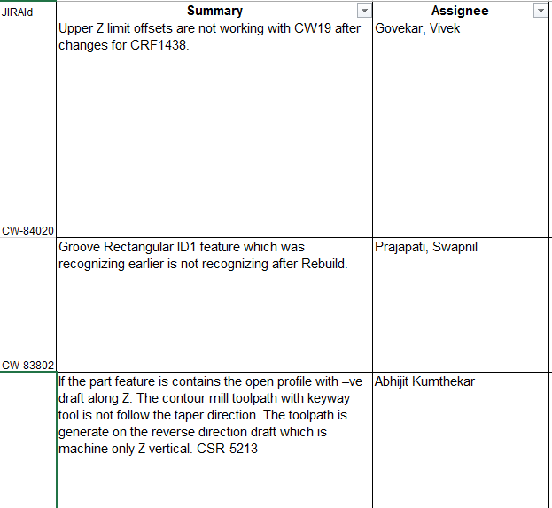
Sample Bug Report
Sample bug report xlsx

Slide 11
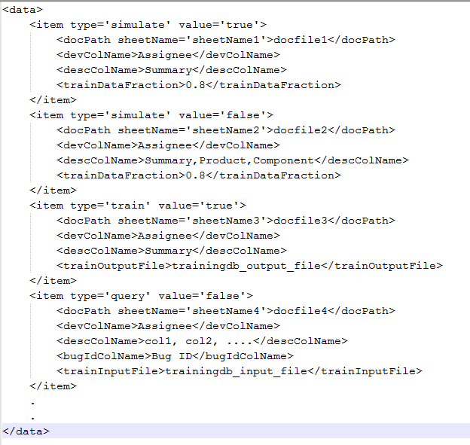
Input XML Sample
Sample file format

Slide 12
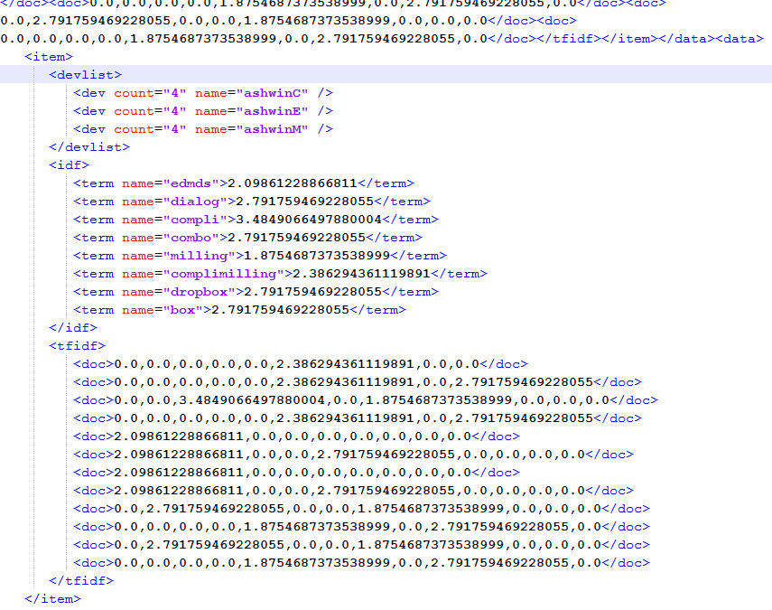
Input/Output Training data XML Sample
<data>
<item>
<devlist>
<dev count='n1‘, name='dev1' ></dev>
<dev count='n2‘, name='dev2'></dev>
.
.
</devlist>
<idf>
<term name='word1'>value1</term>
<term name='word2'>value2</term>
.
.
</idf>
<tfidf>
<doc>value_word1, value_word2, ....</doc>
<doc>value_word1, value_word2, ....</doc>
</tfidf>
</item>
.
.
</data>
Sample file format
Sample file

Slide 13
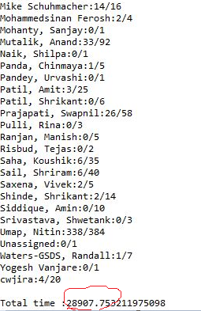
Results of simulation (first iteration)
It went through some iteration, initial iteration for a given set of data, gave accuracy of 30% and took around 8 hour to complete simulation. For the current version we are getting 45-55% accuracy. Also time required is significantly less (a reduction to almost 25% of previous time.)
One of the major improvement was to keep
query data mutually exclusive with the
prediction data. This improved accuracy.
Console output

Slide 14
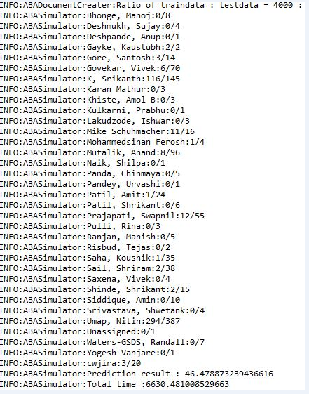
Results of simulation ( improvements )
Team - GTS CamWorks (internal)
Accuracy - 46.47
Data size - 4000 : 994 (train : test)
Computation time - 6630.48 s
Console output

Slide 15
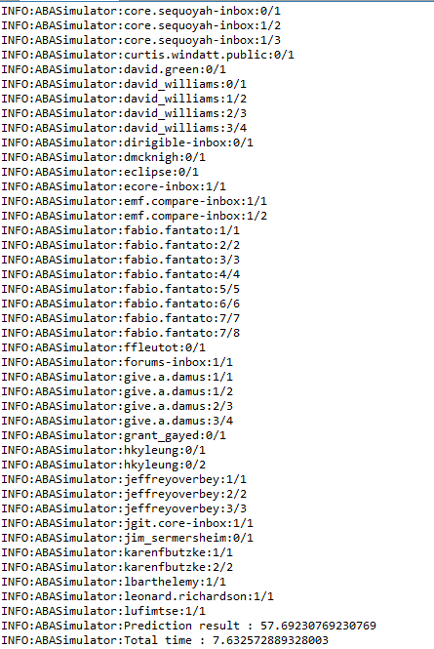
Results of simulation continued ….
Team - Eclipse (external)
Accuracy - 57.69
Data size - 290 : 052 (train : test)
Computation time - 7.63 s
Console output

Slide 16
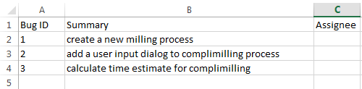
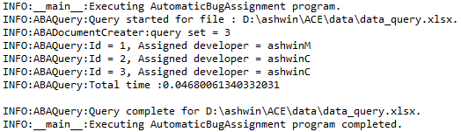
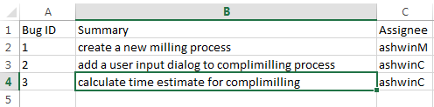
Results of bug assignment
Input xlsx file
Console output
xlsx file after computation

Slide 17
Glossary of terms
Stop words are words which are filtered out before processing of text. Examples are : is, are, they, who, etc. NLTK library’s module ‘corpus’ is used for filtering out stop words.
Stemming and Lemmatization is the process of reducing inflected (or sometimes derived) words to their base or root form. NLTK library’s ‘WordNetLemmatizer’ is used for stemming.
Term Frequency is defined as weight/count of a term that occurs in a document. Logarithmic term frequency is used for the calculation purpose.
tf(t, d) = 1 + math.log(frequency of term in a document)
Inverse Document Frequency for a term can be quantified as an inverse function of the number of documents in which it occurs.
idf(t, D) = log(N / |{d ε D : t ε T}|)
where, N = total number of documents in the corpus.
|{d ε D : t ε T}| = number of documents t where the term appears .

Slide 18
Glossary of terms continued ….
Term Frequency - Inverse Document Frequency is a numerical statistic that is
intended to reflect how important a word is to a document in a corpus.
tfidf(t, d, D) = tf(t, d)*idf(t, d)
A matrix representation of each vectored document is created using TFIDF.
Cosine Similarity is a measure of similarity between two non-zero vectors of an inner product space that measures the cosine of the angle between them. Two vectored document are compared using cosine similarity between them.
It is calculated as below :
(dot product of vectors)/ ((magnitude of vector1) * (magnitude of vector2))

Slide 19
System interaction diagram
Accuracy
Simulator
Document Creator
Input Data (bug repository, training database in xlsx and xml format)
Train
Training database
Query
Bug Assignment
Text Classification Utils
Automatic Bug Assignment System

Slide 20
Flow Diagram And Algorithm
document
sanitizing
filter : empty strings, punctuations
filter : stop words
stemming and normalizing
for each unique term in all documents calculate term frequency tf(t, d) for document, d
TF
tokenizing
tokenized document
for each unique term in all documents calculate inverse document frequency, (idf(t, D))
IDF
continued ….

Slide 21
Flow Diagram And Algorithm continued ….
TF
calculate TFIDF representation matrix for all documents, tfidf(t, d, D)
TFIDF matrix
compare cosine similarity between two documents
IDF

Slide 22
Future Work
Though performance of algorithm is not as high as expected, the results are promising for further investigation. If it can be fine tuned with the help of developers for a particular project, performance can be improved. For example, we can add to list of stop/ignore words.
If we can use term-weighting technique by associating some metadata with the terms. For example, SVN logs can be searched for such metadata such as who made what changes in project.
This can be combined with other technique/tools such as Naive Bayes classifier to improve upon the results.

Slide 23
Summary
The evaluation of this product shows that it can predict 40-60 reports assigned to developer. Since Text Classification/Information Retrieval involves Natural Language Processing they are difficult to predict accurately. With this result it can be easily integrated into bug-repository. Miss prediction could be easily handled in light weight fashion by their assignee. They can reassign it to others for human intervention. Even at this accuracy it will significantly reduce the load for human intervention.

Slide 24
Thank You!

